Slide 1
Department of Gender, Sexuality, & Women’s Studies
Proposal Presented to UCC, April 20, 2021
Bonnie Moradi, PhD
Professor of Psychology
Director of Center for Gender, Sexualities, & Women’s Studies Research
University of Florida

Slide 2
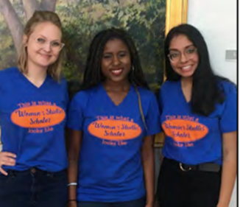
Department Proposal
Aligns UF with top institutions
U.S. public universities ahead of UF in rankings have department AND Center - Appendix A
Robust shared governance review and support

Slide 3
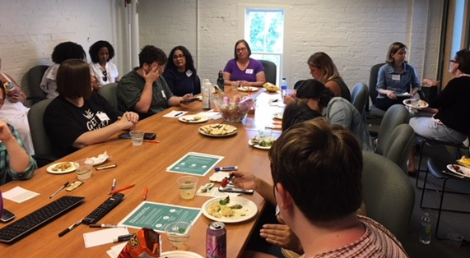
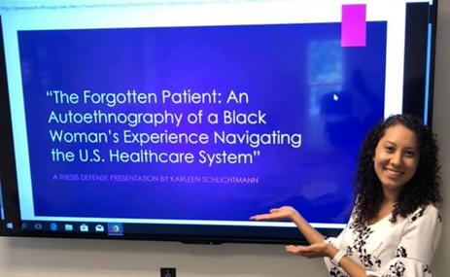
Department Proposal
No new resources required
Award winning faculty, undergrad program, grad program
Department functions well-established
Bylaws, administrative and student advising structure, policy and procedures including t&p guidelines, faculty and grad student mentoring guidelines, merit guidelines
Make Department and Center functions visible to national and international reputation makers and local constituents
Recognizes robust and established discipline
Recognizes distinct Department and Center contributions of GSWS at UF

Slide 4
January 2019
Submitted to:
✓ Dean’s office
February 2019
Submitted to:
✓ CLAS Faculty Assembly
✓ CLAS Faculty Council
✓ CLAS Curriculum Committee
March 2019
Reviewed and supported by:
✓ CLAS Faculty Council
✓ CLAS Curriculum Committee
April 2019
Reported to CLAS Faculty Assembly:
✓ CLAS Faculty Council support
✓ CLAS Curriculum Committee support
March 2020
CLAS Faculty vote ✓ 85%
Department Proposal

